Slide 1
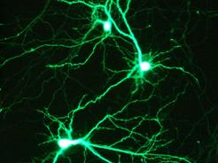
Electrophysiological biomarkers of gene modulation in the Alzheimer’s disease pathway
Ajay Karpur

Slide 2
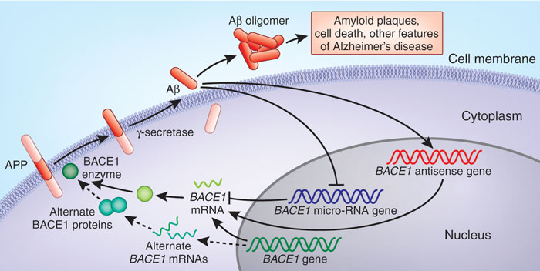
Introduction

Slide 3
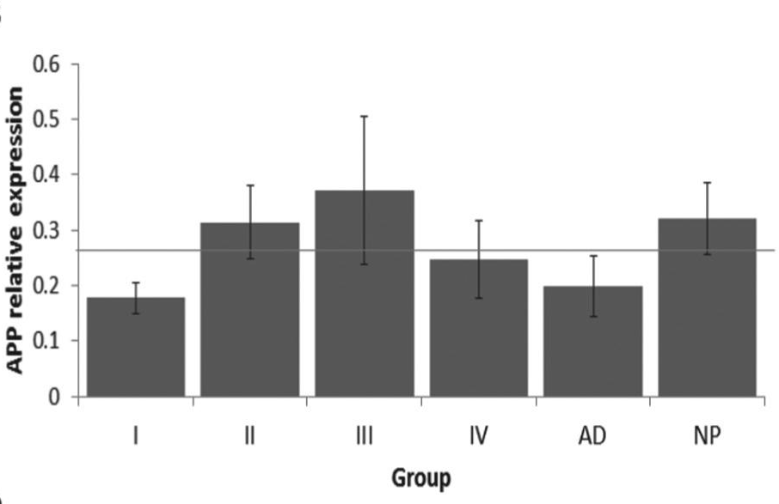
Introduction
conventional protein measurements…

Slide 4
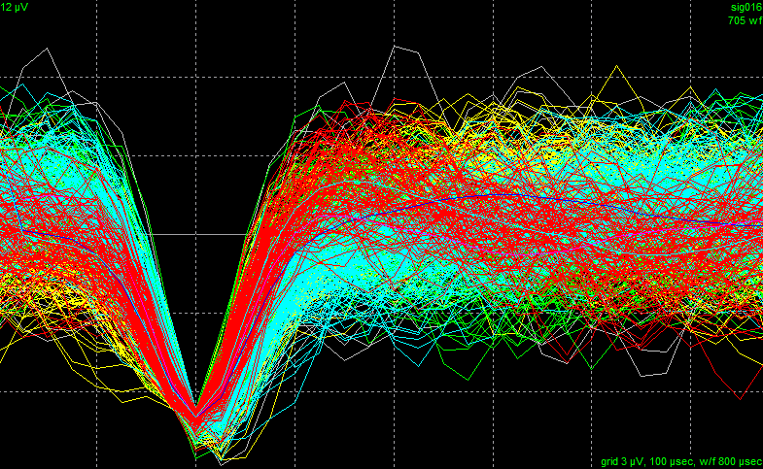
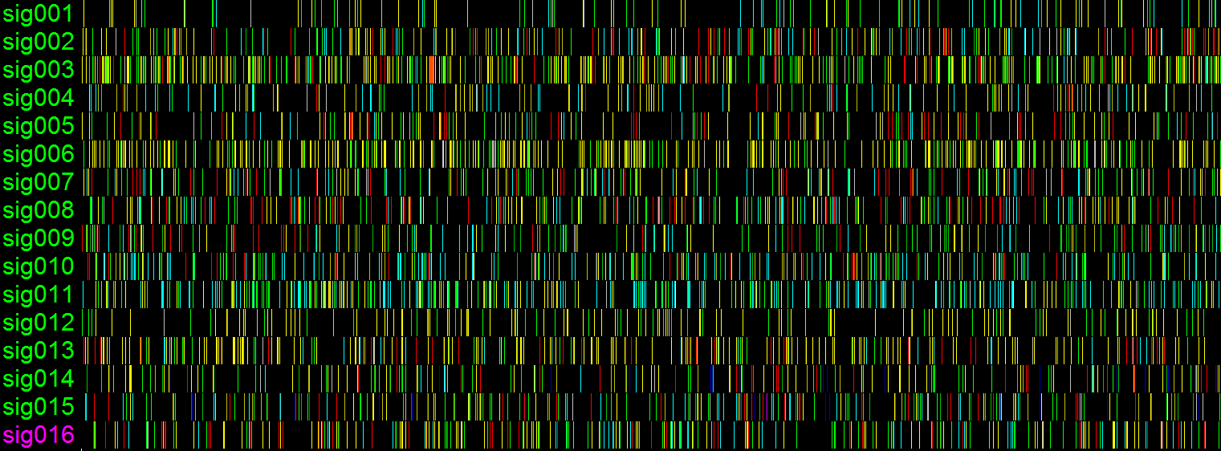
Introduction
electrophysiology

Slide 5
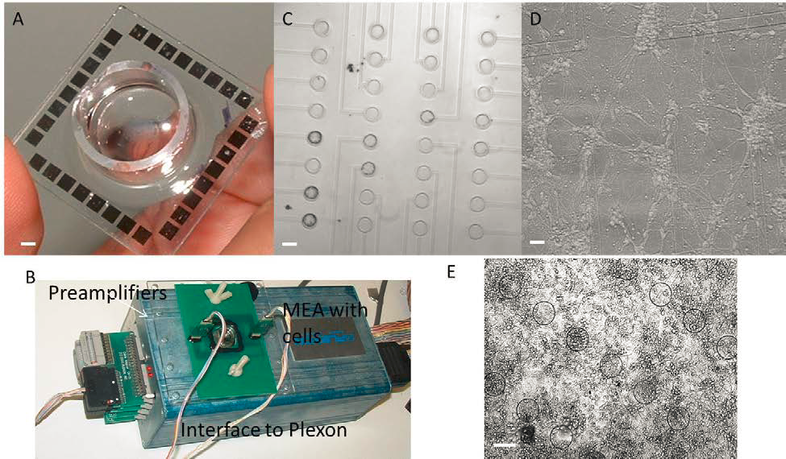
Methods
Notes:
A. A transparent 32-channel microelectrode array (MEA) with paryleneinsulation custom fabricated in house. Bar indicates 2 mm.
B. The MEA is coupled to a custom PCB interface to a Plexonreal-time signal acquisition system.
C. Close-up view of electrodes (100 μmdiameter). Bar indicates 100 μm.
D. A medium density, primary hippocampal neuron culture (DIV7) (6-10 cell bodies/ microelectrode) Bar indicates 100 μm.
E. A high density, primary hippocampal neuron culture (DIV7) (20-40 cell bodies/ microelectrode) Bar indicates 100 μm. Circles indicate position of electrodes.

Slide 6
Results

Slide 7
Results

